Slide 1

Hawking Radiation And Unruh Temperature with Recent Phenomenology
Nikshay Chugh
Sophomore, BS(Res)

Slide 2
iNTRODUCTION

Slide 3
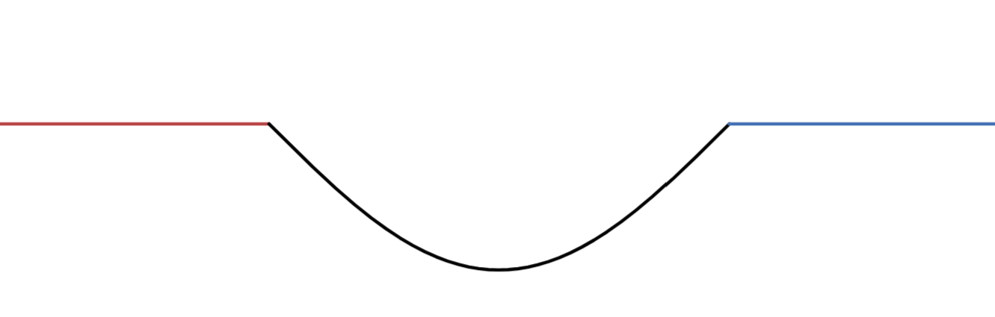
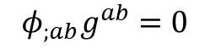
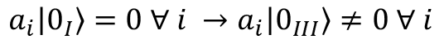
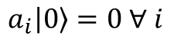
Curvature and Particle Creation
A massless scalar field obeys:
I
III
$$φ_{;ab}g^{ab}=0$$
Its vacuum state follows
II
$$a_{i}\left|0\right\rangle =0 ∀ i$$
The vacuum state for regions I, II, and III is not the same
The curvature of spacetime implies particle creation.
Found in time-dependent metrics
In Black holes
$$a_{i}\left|0_{I}\right\rangle =0 ∀ i →a_{i}\left|0_{III}\right\rangle ≠0 ∀ i$$

Slide 4
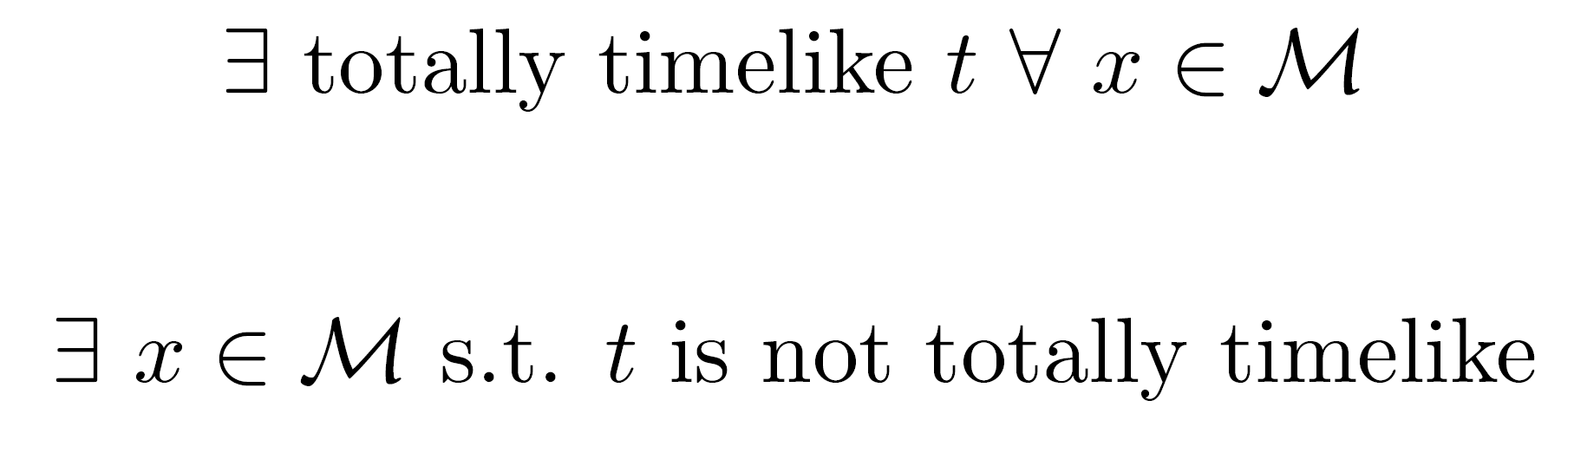
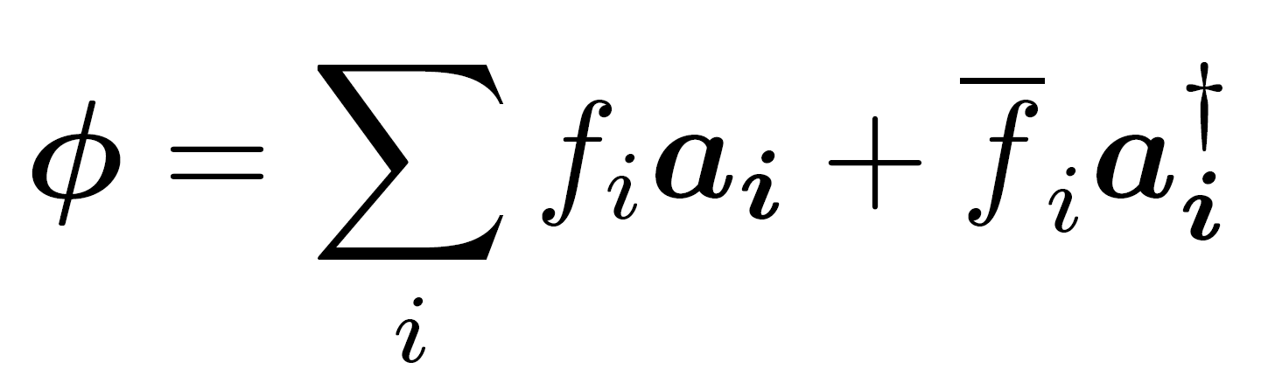
Quantum Field Theory in Curved Spacetime
Maximal Minkowski Spacetime
Generic Spacetime

Slide 5
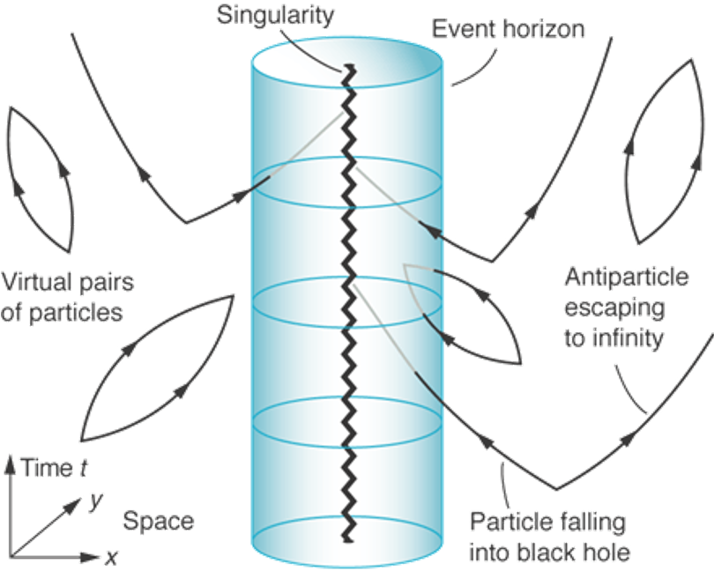
Qualitative Picture
Semiclassical Approximation:
Metric is Classical
Matter is Quantized
Particle-Antiparticle Pairs
Positive ‘Energy’
Negative ‘Energy’
Credits: Marco Tavora

Slide 6
EXPLICIT QUANTUM FIELD THEORY

Slide 7
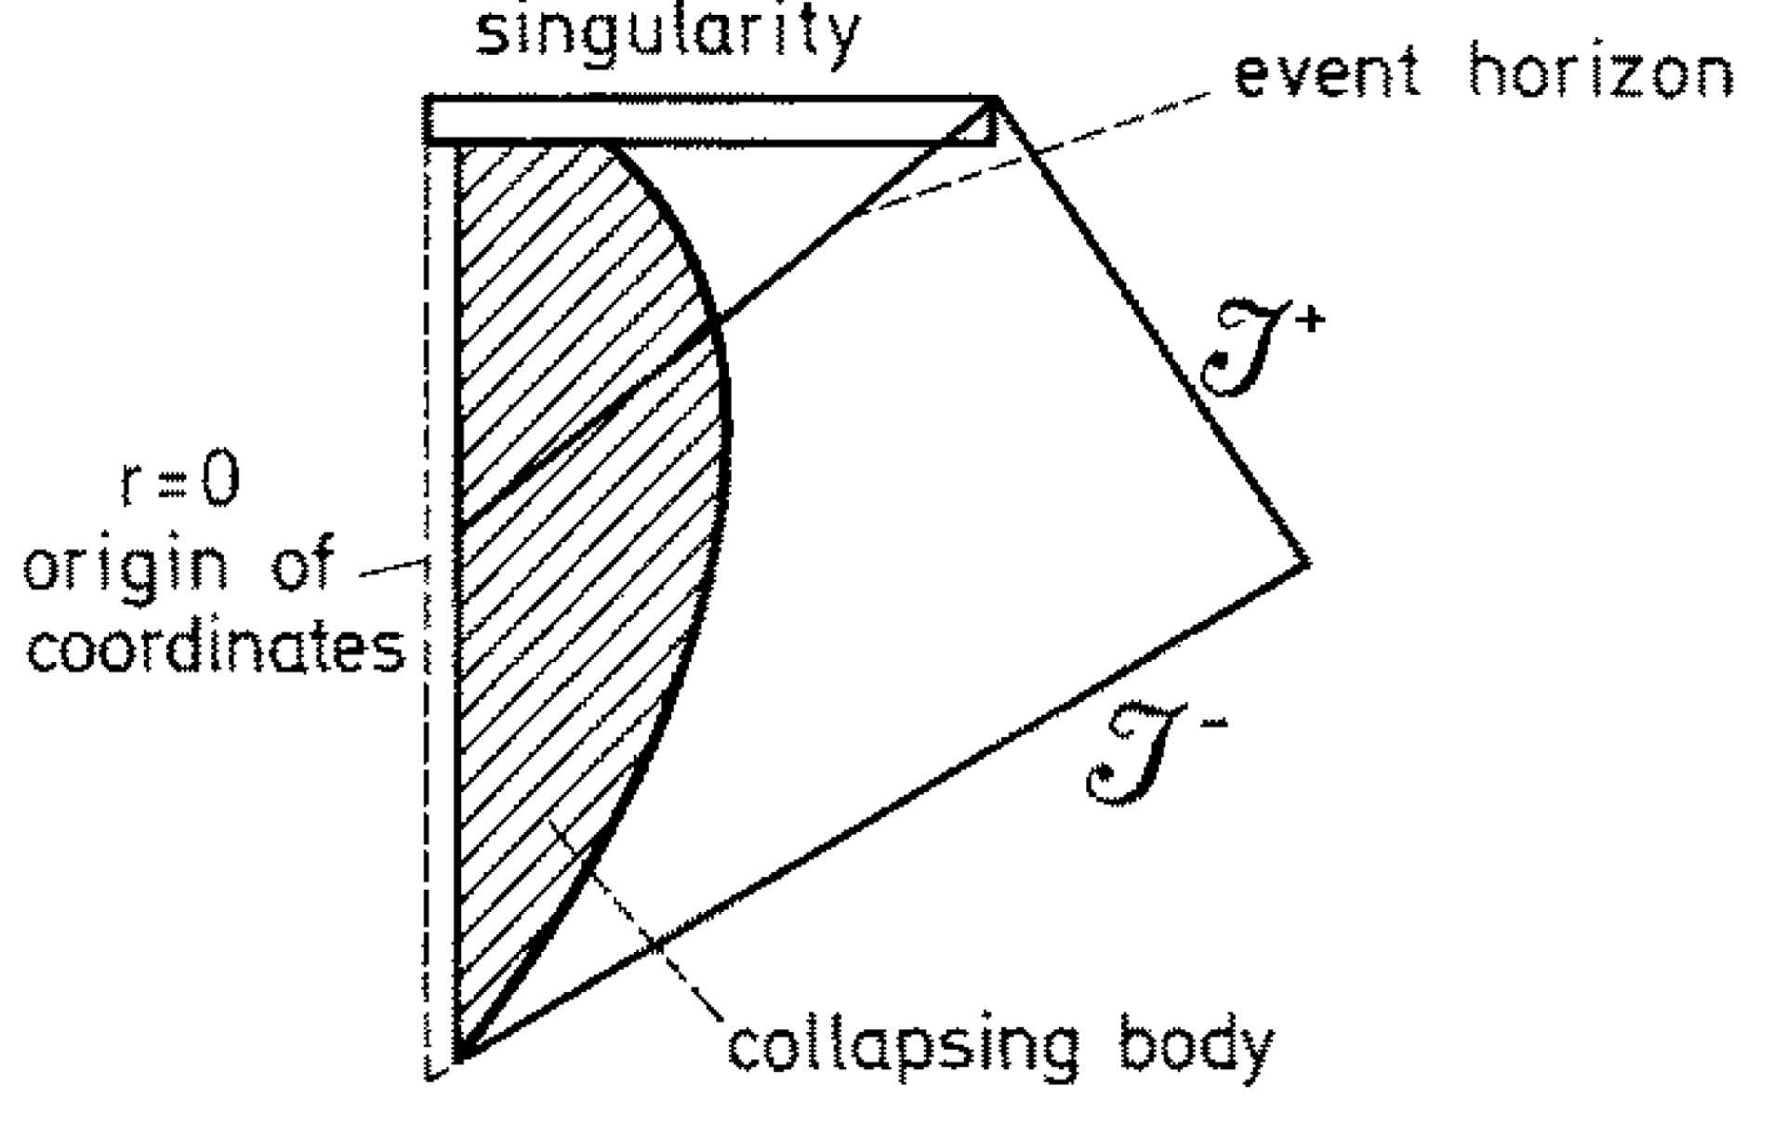
Spherically Collapsing Matter

Slide 8
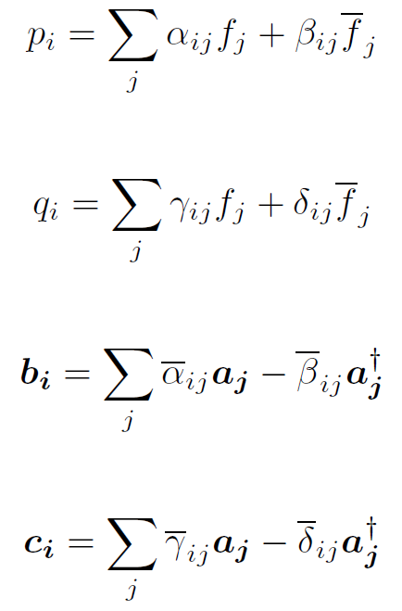
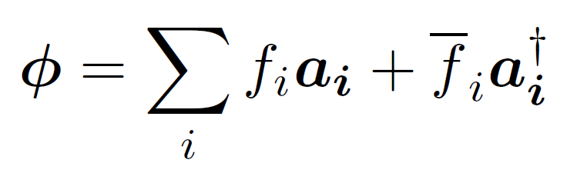
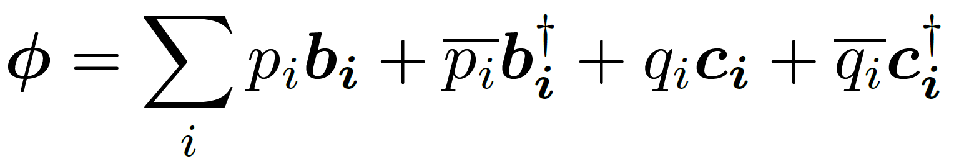
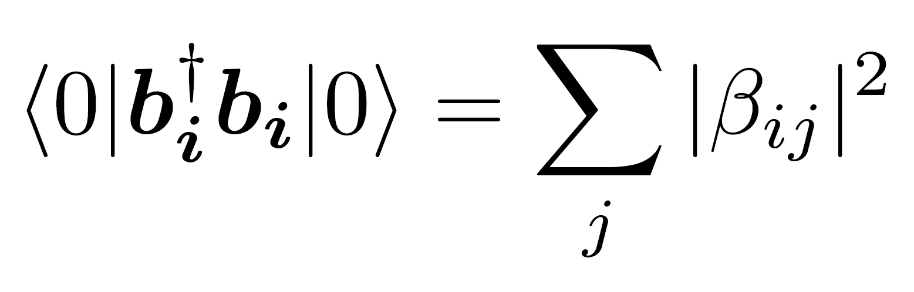
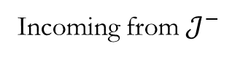
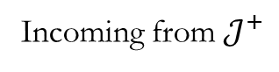
Time-Reversal Symmetry
Incoming from $𝒥^{−}$
Incoming from $𝒥^{+}$
Why is this important?

Slide 9
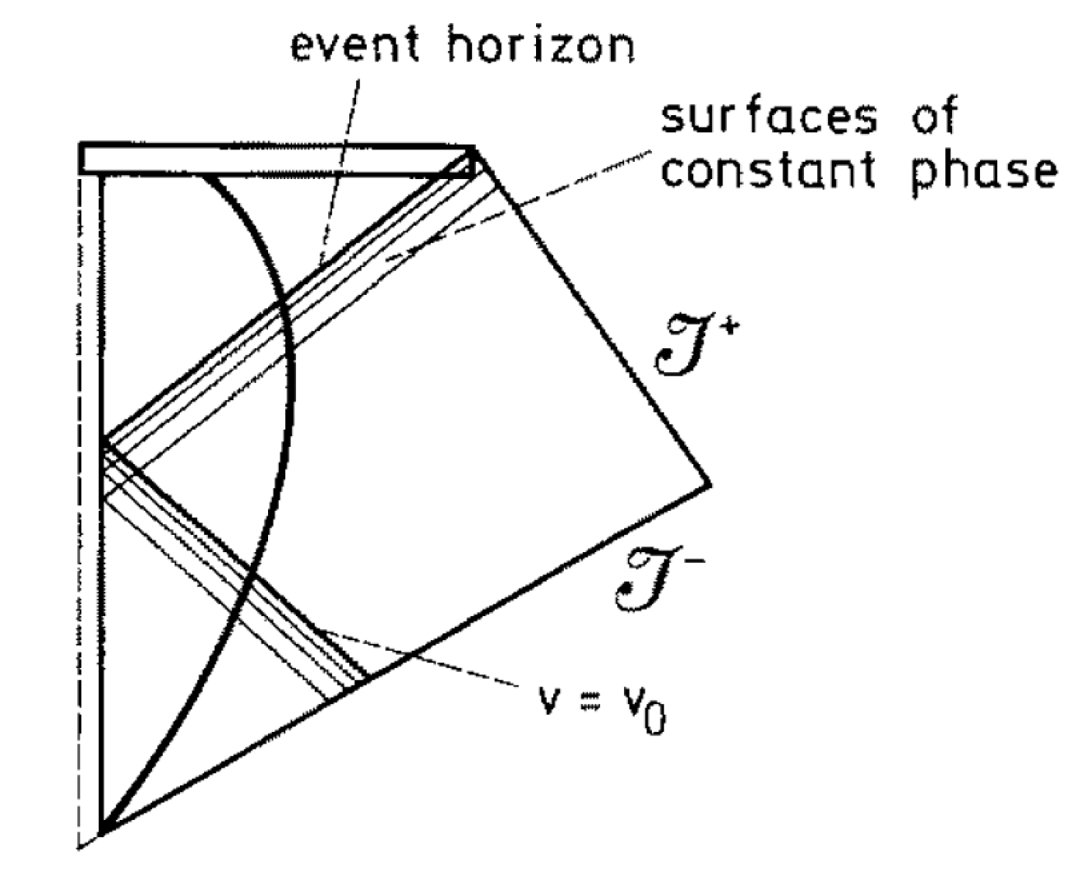
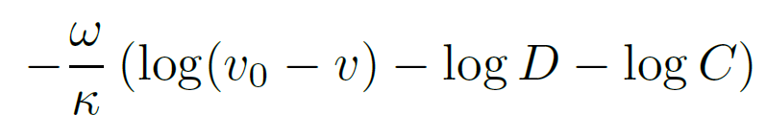
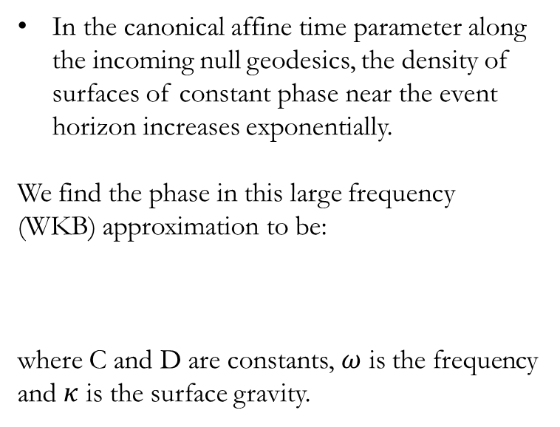
Geometric Optics Approximation
In the canonical affine time parameter along the incoming null geodesics, the density of surfaces of constant phase near the event horizon increases exponentially.
We find the phase in this large frequency (WKB) approximation to be:
where C and D are constants, $ω$ is the frequency and $κ$ is the surface gravity.

Slide 10
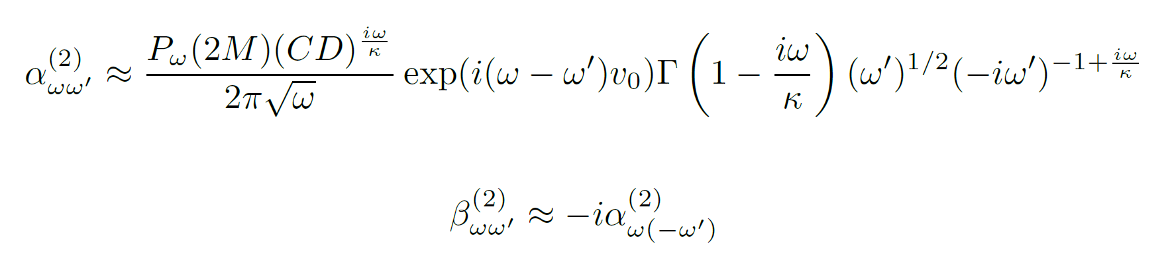
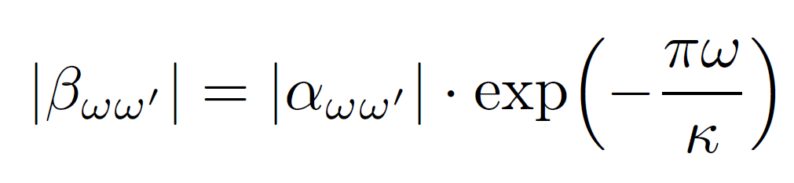
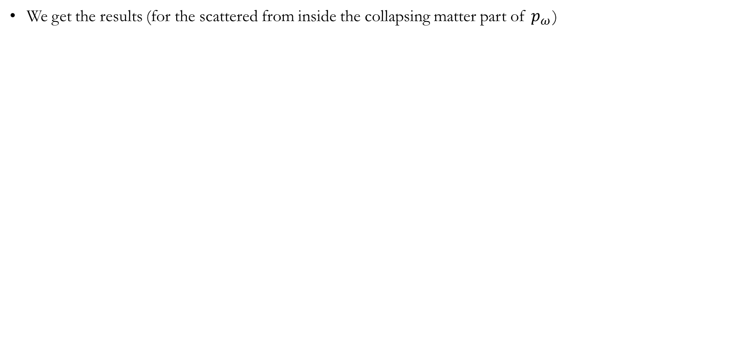
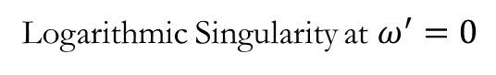
Some Algebra
We get the results (for the scattered from inside the collapsing matter part of $p_{ω}^{}$)
Logarithmic Singularity at $ω^{′}=0$

Slide 11
Intermediate results

Slide 12
Higher-order massless bosonic fields like electromagnetism and linearized gravity also show radiance in a Schwarzschild solution.
Massless fermionic fields have a slightly different computation but exhibit the same temperature.
Massive fields are emitted only if the thermal energy is greater than the rest mass of the corresponding field.
Non-spherical collapse is allowed in the solution.
Kerr-Newmann black holes exhibit modified behavior and are still radiant.
Back reaction on the metric due to this emission will lead to quasi-stationary evaporation and eventual explosion at the Planck scale.

Slide 13
Path Integral Formulation

Slide 14
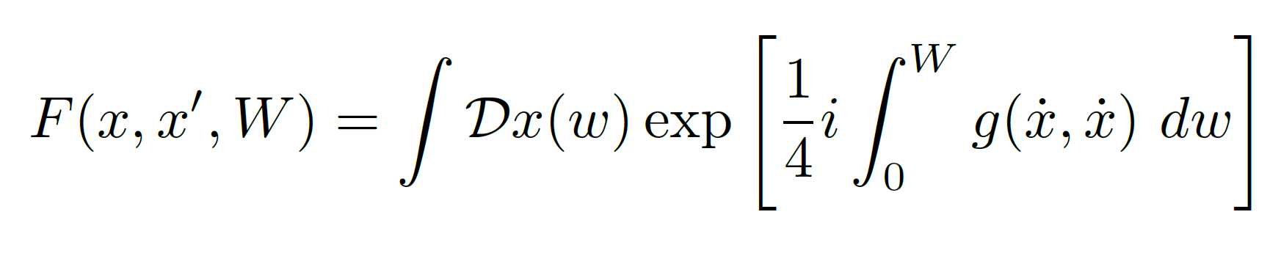
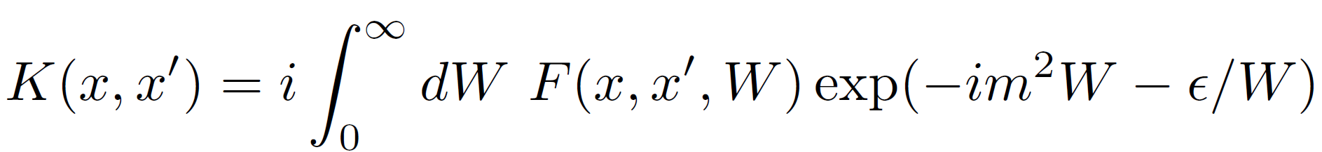
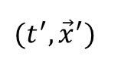
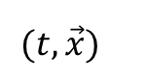
What is a Propagator?
$$(t, \vec{x})$$
parameter time
along the curve
W
$$(t^{′}, {\vec{x}}^{′})$$

Slide 15
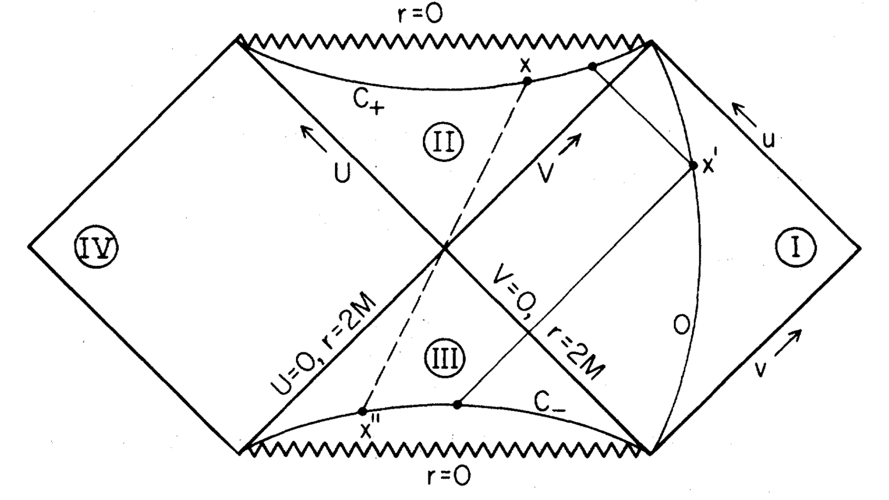
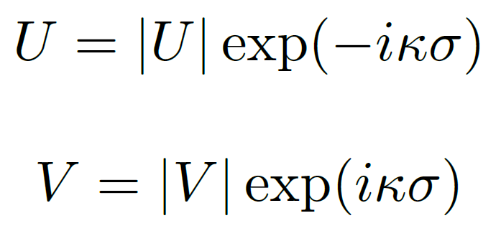
Analyticity properties 1

Slide 16
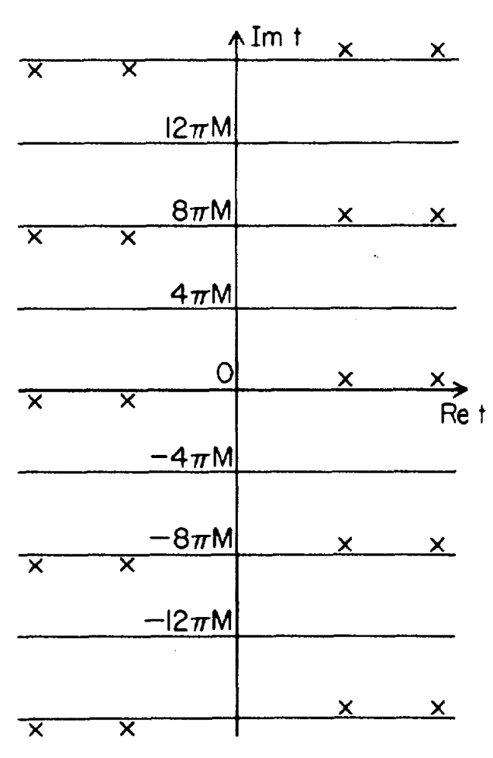
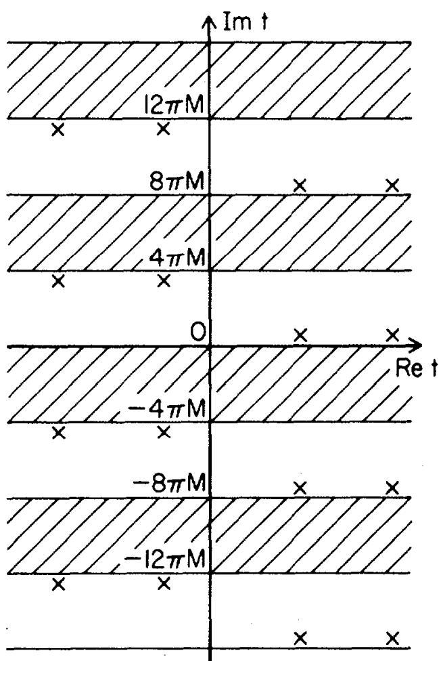
Analyticity properties 2

Slide 17
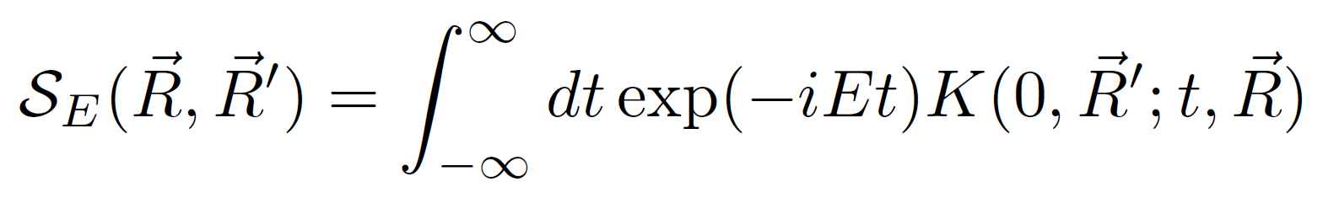
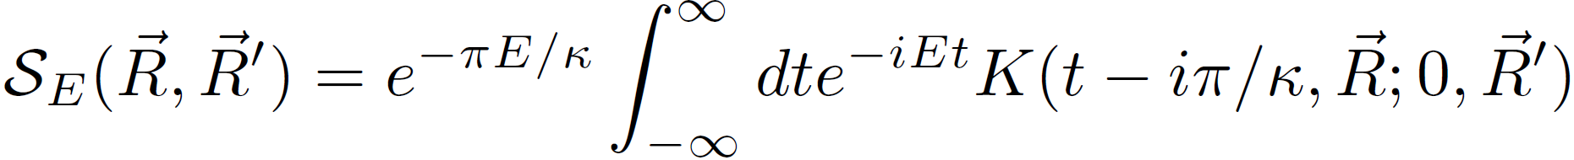
Temperature of Black Hole
Amplitude to go from Region I to II with energy E
Amplitude to go from Region I to III with energy E, but now multiplied by a factor of $e^{−πE/κ}$

Slide 18
Rindler Coordinates

Slide 19
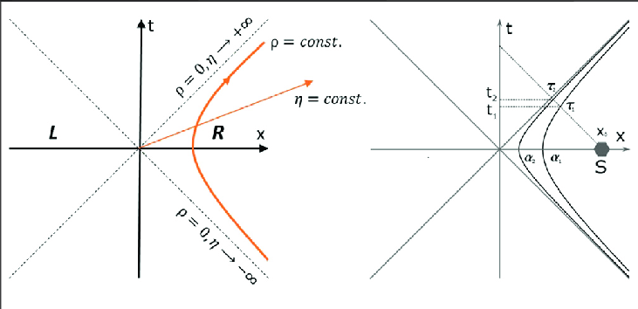
Euclidean Field Theory
Dimić, Aleksandra & Milivojevic, Marko & Gočanin, Dragoljub & Salomé Móller, Natália & Brukner, Časlav. (2020). Simulating Indefinite Causal Order With Rindler Observers. Frontiers in Physics. 8. 10.3389/fphy.2020.525333.

Slide 20
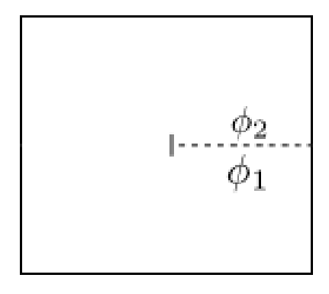
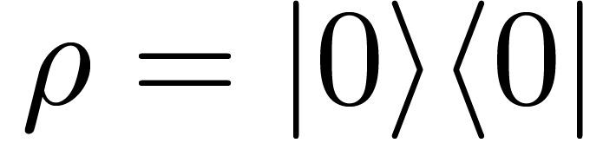
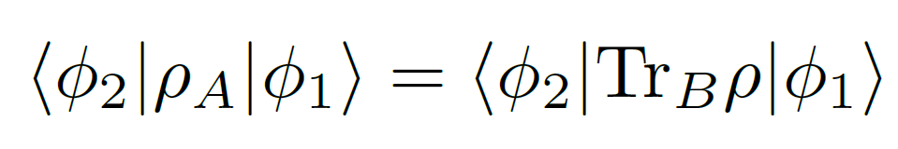
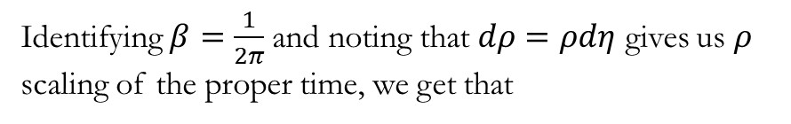
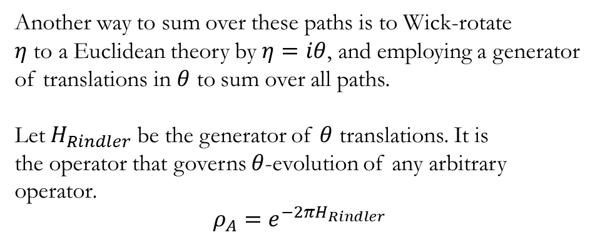
Density Matrix Formalism
Minkowski Vacuum
A
Another way to sum over these paths is to Wick-rotate
$η$ to a Euclidean theory by $η=iθ$, and employing a generator
of translations in $θ$ to sum over all paths.
Let $H_{Rindler}$ be the generator of $θ$ translations. It is
the operator that governs $θ$-evolution of any arbitrary
operator.
$$ρ_{A}=e^{−2πH_{Rindler}}$$
B
Identifying $β=\frac{1}{2π}$and noting that $dρ=ρdη$ gives us $ρ$ scaling of the proper time, we get that

Slide 21
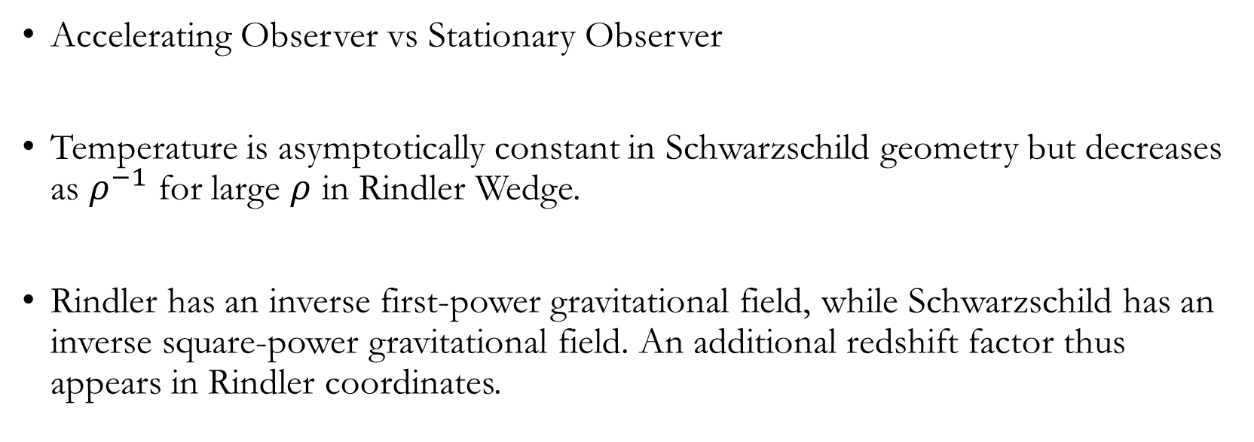
Rindler vs Schwarzschild
Accelerating Observer vs Stationary Observer
Temperature is asymptotically constant in Schwarzschild geometry but decreases as $ρ^{−1}$ for large $ρ$ in Rindler Wedge.
Rindler has an inverse first-power gravitational field, while Schwarzschild has an inverse square-power gravitational field. An additional redshift factor thus appears in Rindler coordinates.

Slide 22
Response functions

Slide 23
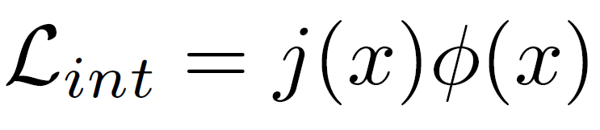
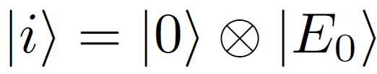
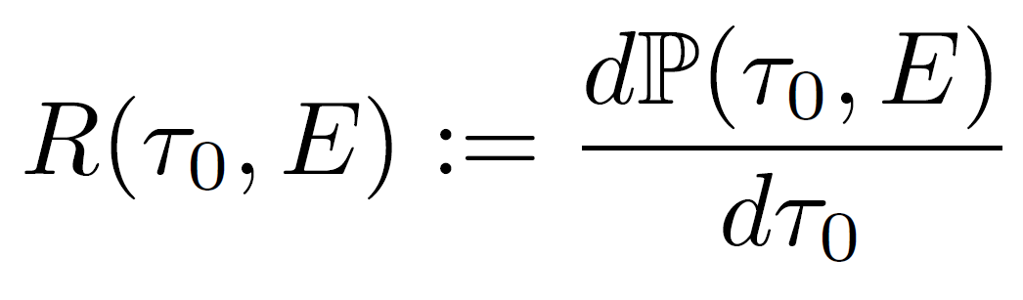
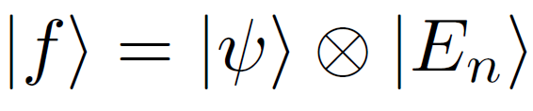
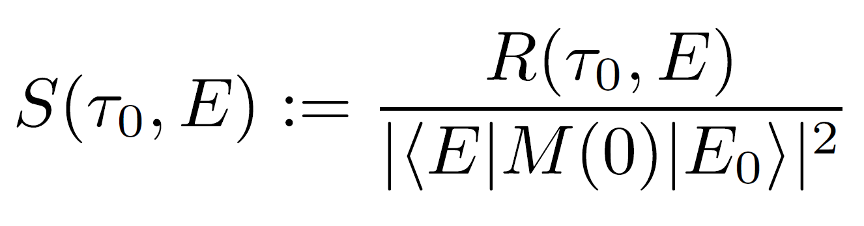
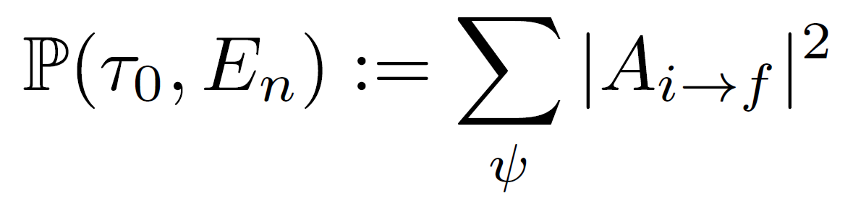
Unruh-DeWitt Detector
A particle-sized detector with some internal discrete energy spectrum is coupled to a background Minkowski spacetime.

Slide 24
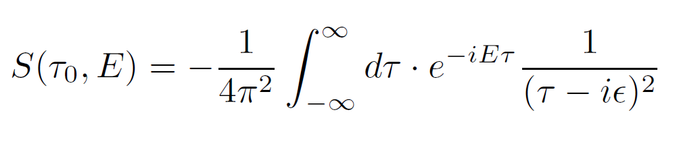
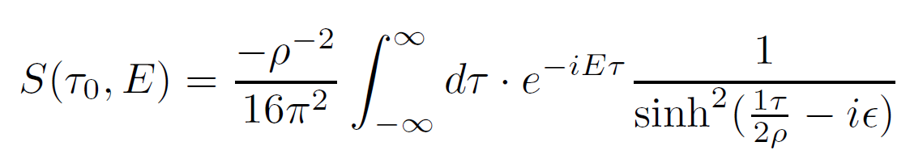
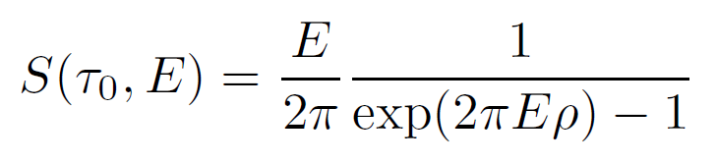
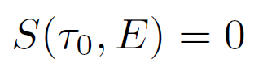
InertiaL Observers
Rindler
Observers

Slide 25
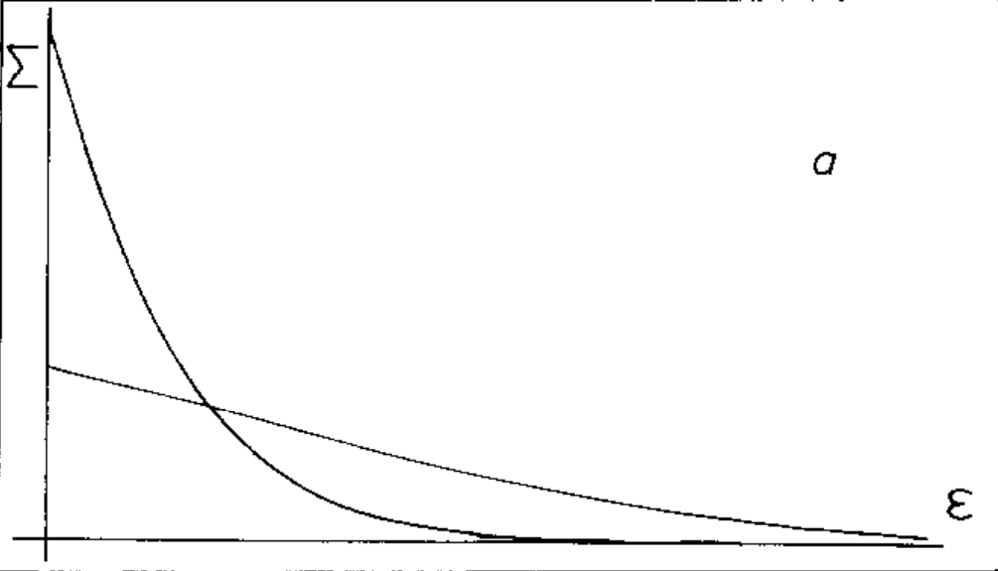
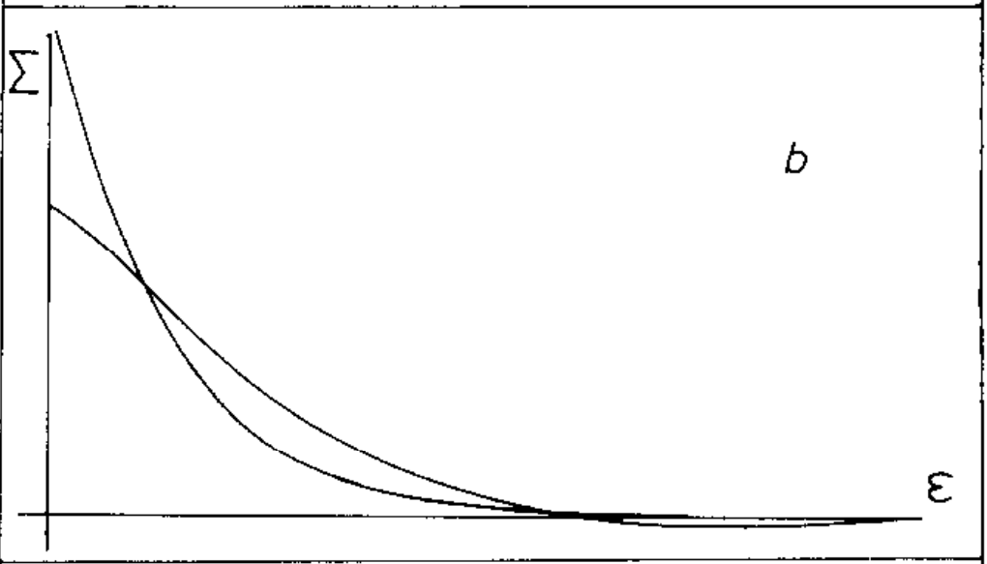

Just Starting to Accelerate
Dimensionless Response Function vs Dimensionless Energy difference for different $τ_{0}$

Slide 26



Just Stopped Accelerating
Dimensionless Response Function vs Dimensionless Energy difference for different $τ_{0}$

Slide 27
Experiments

Slide 28


Decay of Accelerated Protons
In inertial (Minkowski) frames, decay is observed as
In non-inertial (Rindler) frames, decay can be by the combinations of

Slide 29

Recoil Radiation in crystals
Wistisen, T.N., Di Piazza, A., Knudsen, H.V. et al. Experimental evidence of quantum radiation reaction in aligned crystals. Nat Commun 9, 795 (2018).
Wistisen, Tobias & Piazza, A. & Nielsen, Christian & Sørensen, A. & Uggerhøj, U.. (2019). Quantum radiation reaction in aligned crystals beyond the local constant field approximation. Physical Review Research. 1. 10.1103/PhysRevResearch.1.033014.

Slide 30

Proposal to Measure Berry Phase Difference
Minkowski vacuum is a pure state.
Rindler vacuum is a mixed state.
Consider a Unruh-DeWitt detector weakly coupled to some massless scalar field in a background Minkowski spacetime, and peaked at some frequency mode.
$φ=kx −Ω$ is the periodic phase for a Minkowski observer.
$δ=γ_{Inertial}−γ_{Rindler}$ depends on the acceleration and can be measured.

Slide 31


Slide 32


Slide 33
Timeline
1972
1974
1975
1976
Till Present
Fulling studies Scalar fields in universes of constant curvature. Proves non-uniqueness of canonical quantization
Hawking and Davies start working on particle creation effects in general relativity
Davies and Hawking publish results in the same year taking very different approaches.
Unruh publishes his notes on Black hole evaporation. Hawking and Hartle use path integrals to rederive the result.
Researchers working to put these notions on a concrete basis.

Slide 34

Thank You

